Slide 1
define the website as the input of innovation
register on the website and enter their personnel number if they are employees
People are paid for registering each idea
If the ideas come to fruition
It can make all the people eager to give good ideas
Weekly collecting data
Giving Ideas to the relevant department
If the idea leads to a high-profit sale, a part of the profit is given to that person

Slide 2
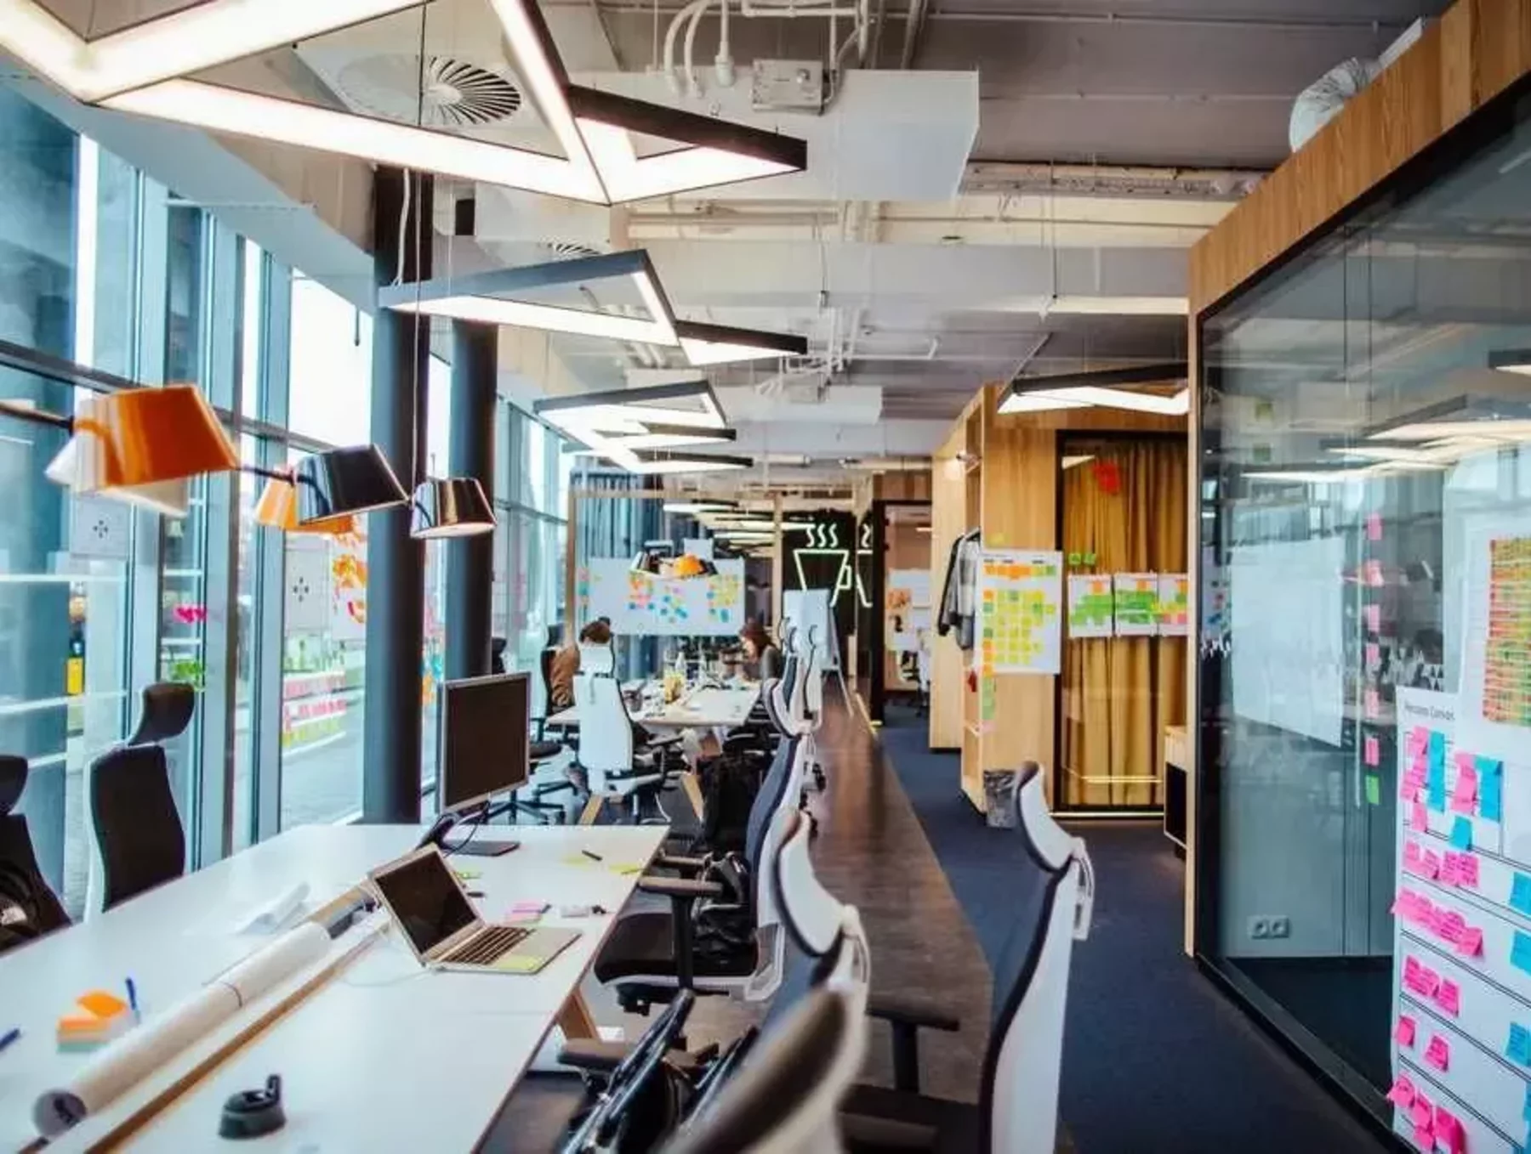
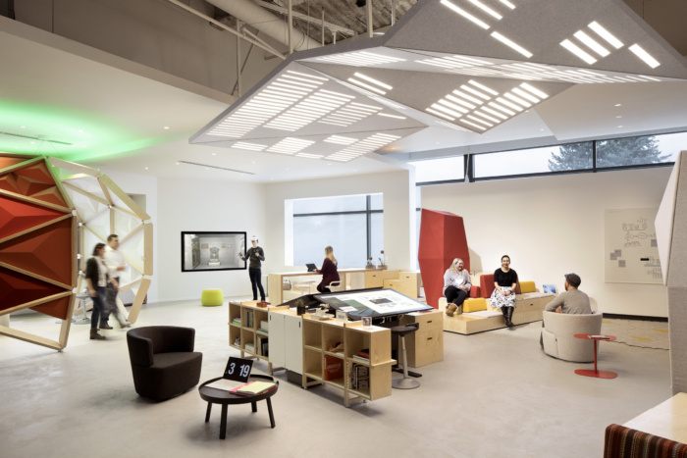
Preparing a room full of equipment and allocating time to generate new ideas is highly recommended
1- Internal team members Idea
Each department supposes to bring at least two ideas a year
2- Taking Idea from consumers

Slide 3
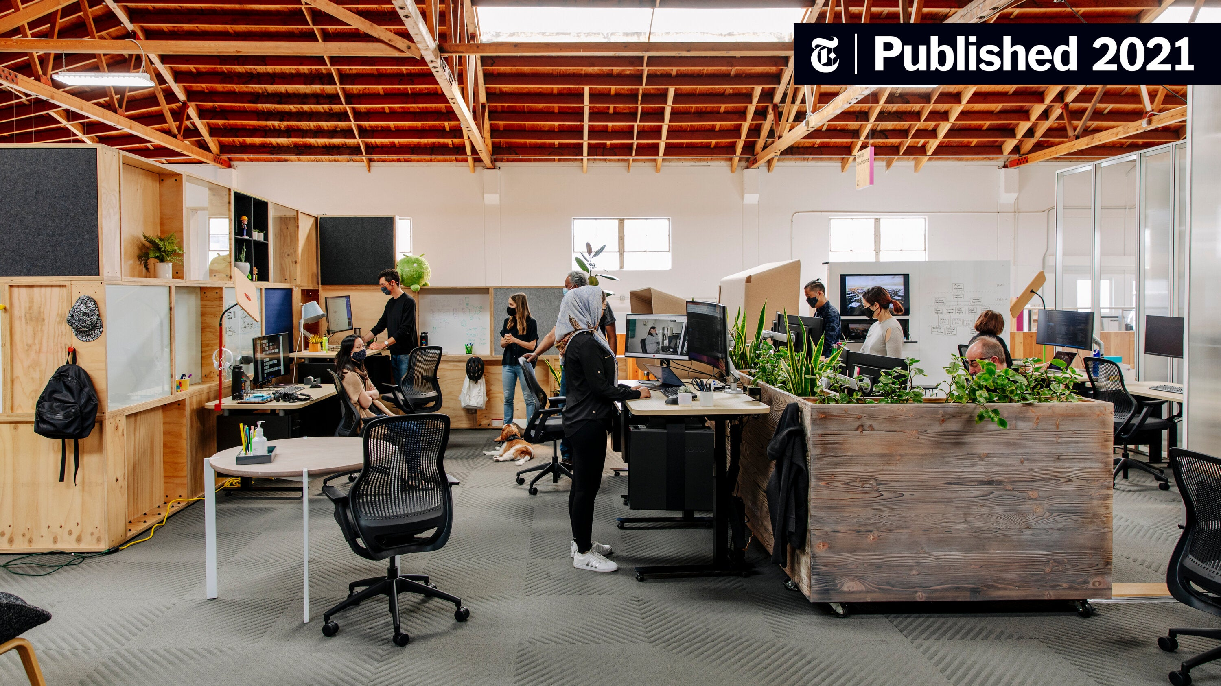
1- Internal ideas come from research and best practices worldwide
Finding a product with successful market in other countries
Ideas
R&D Dep.
Sample Product
Approval
New Production Line
Production Feasibility
Evaluation of Production with Existing Facilities
Announcing the conditions
Machinery and Raw materials Engineering Dep. Procurement Dep.
produces the sample product
Cost Estimation

Slide 4
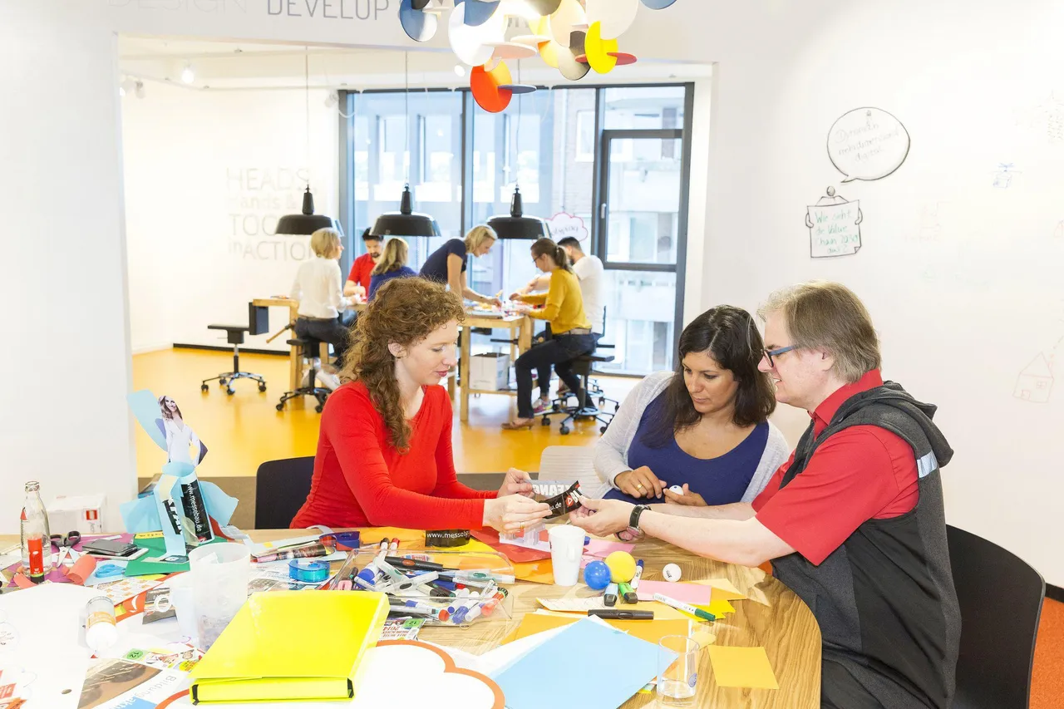
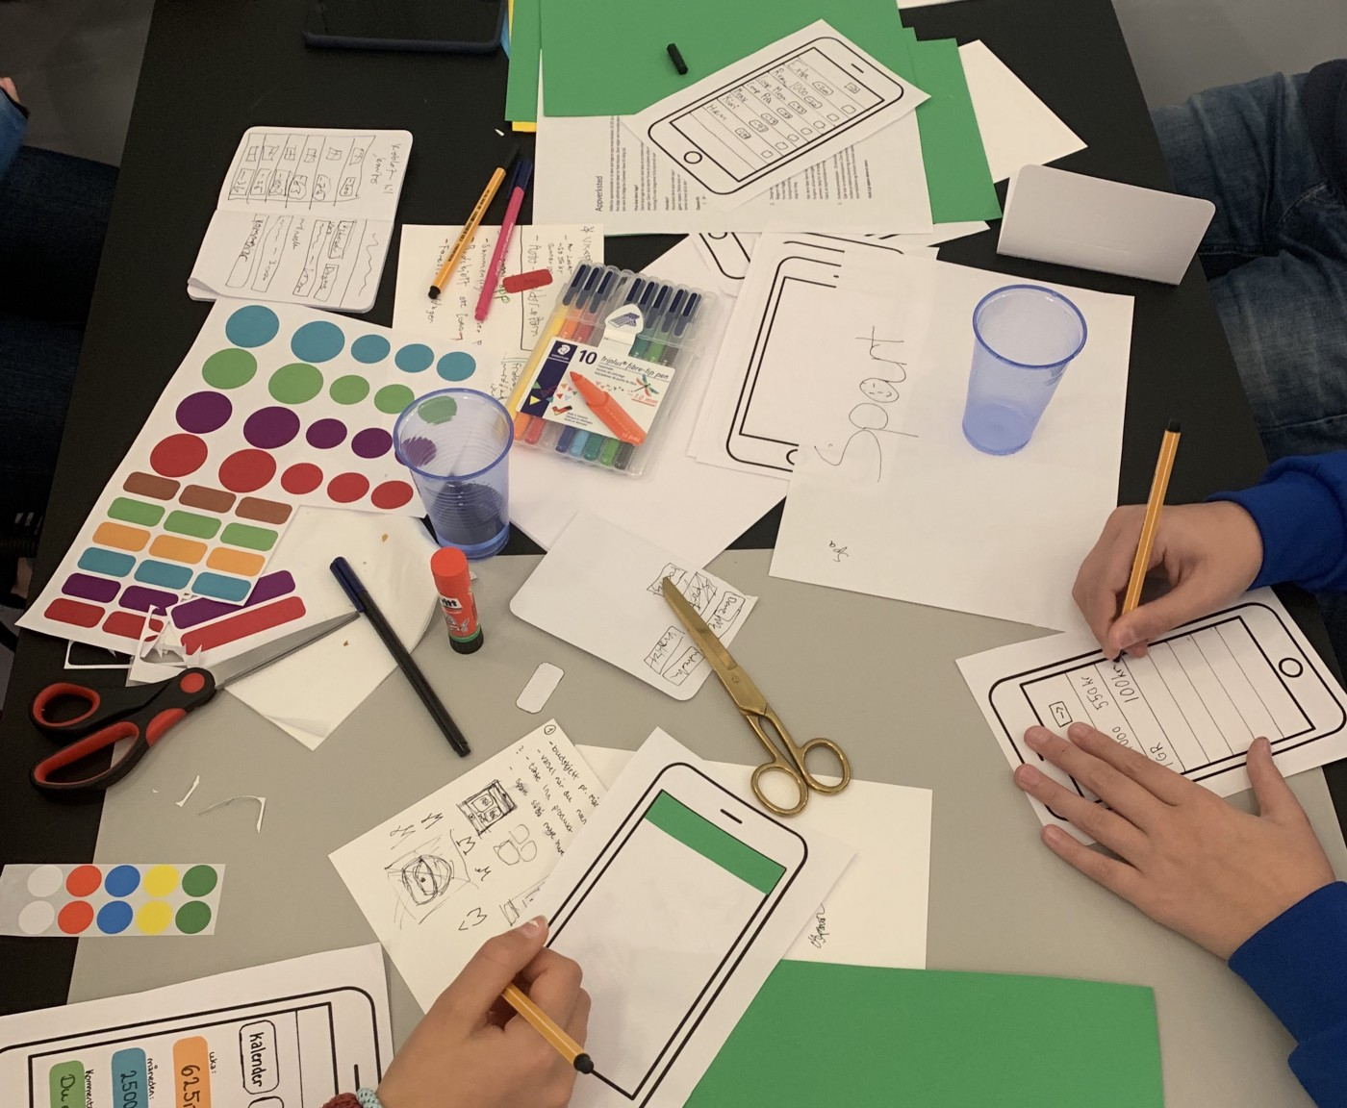
2- Taking Idea from consumers
consumers aged 20 to 50 with a diploma to a master's degree
Determining the purpose and attitude of the target consumers
Forming focus groups by Research companies
R&D Dep. Select best Ideas with higher frequency between Market demands Ideas
Examining Product type, Packaging size, Taste, Flavor etc.
Production Feasibility
Evaluation of Production Facilities
Announcing the conditions
Machinery and Raw materials
produces the sample product
Cost Estimation
professional brainstorming
using tools
let everyone creatively express
preparing questions and games from R&D and L&L
Launching the New Product
Preparing the Packaging Shape by Design group
Using data from market research companies, we can hold workshops for our loyal customers

Slide 5
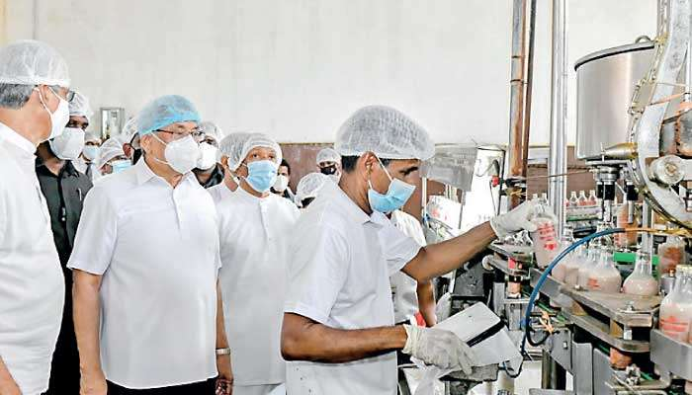
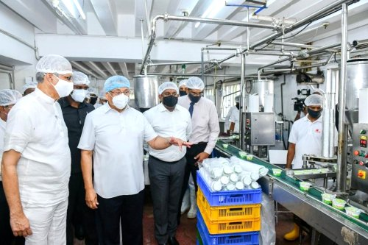
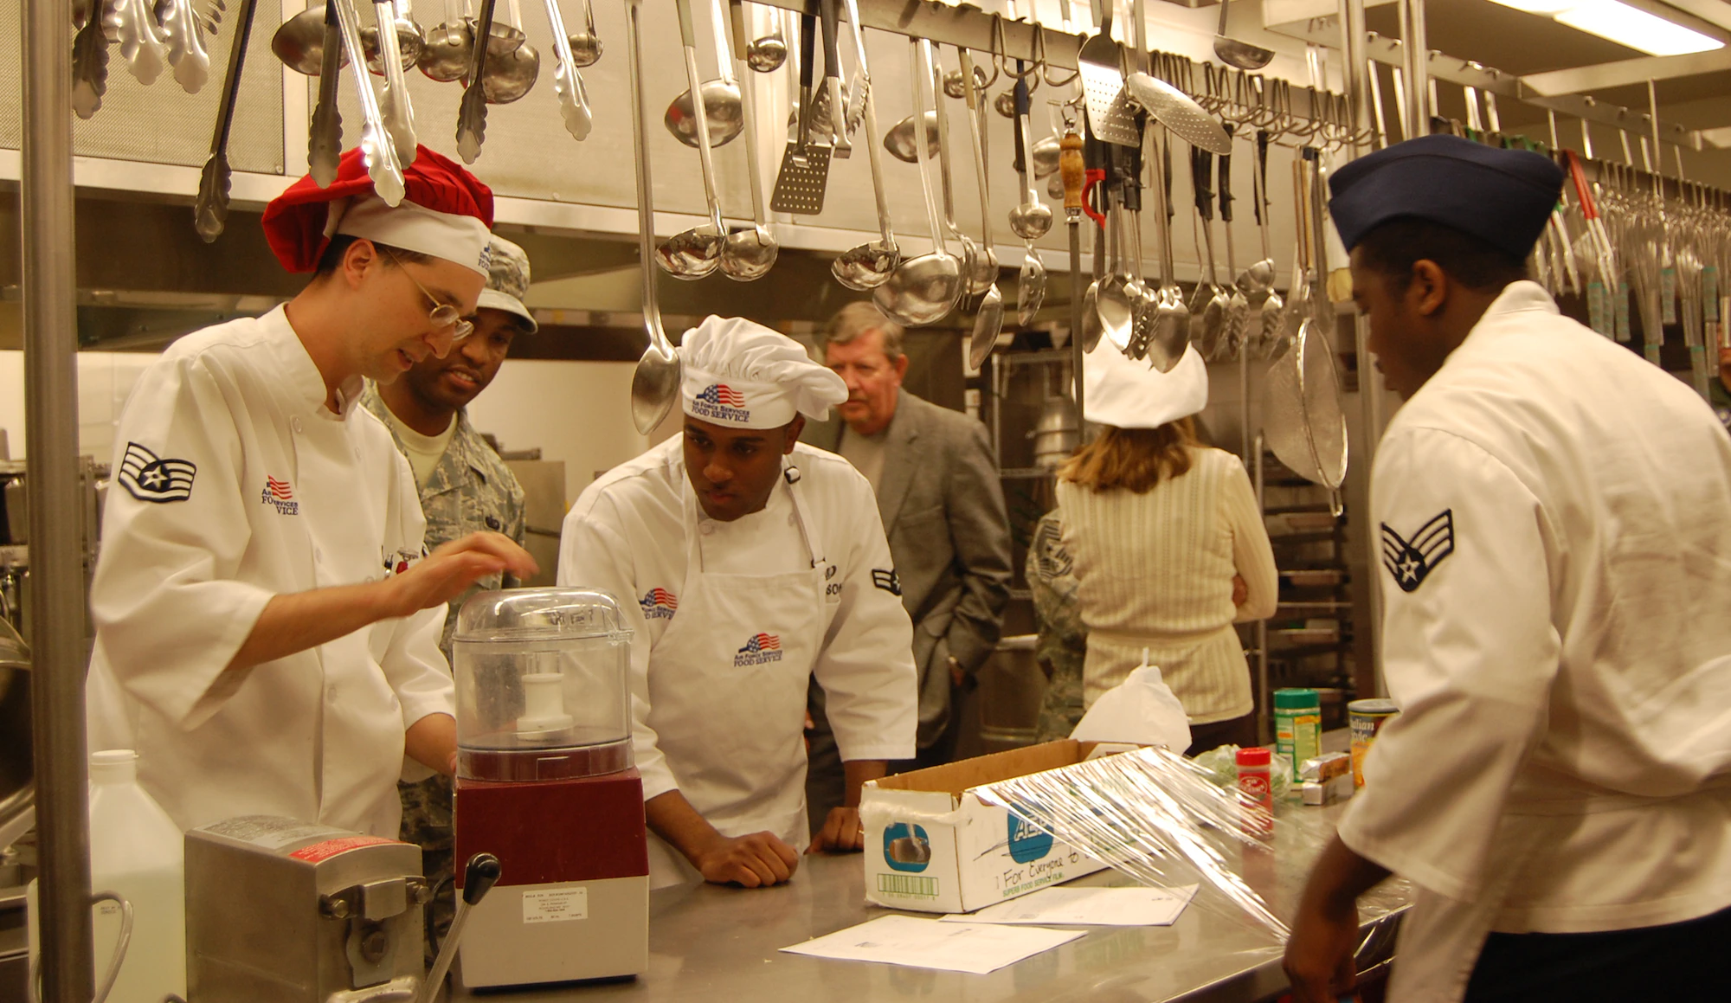
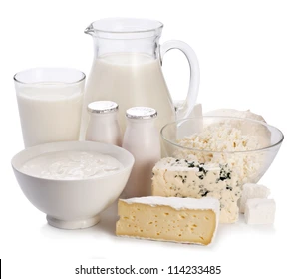
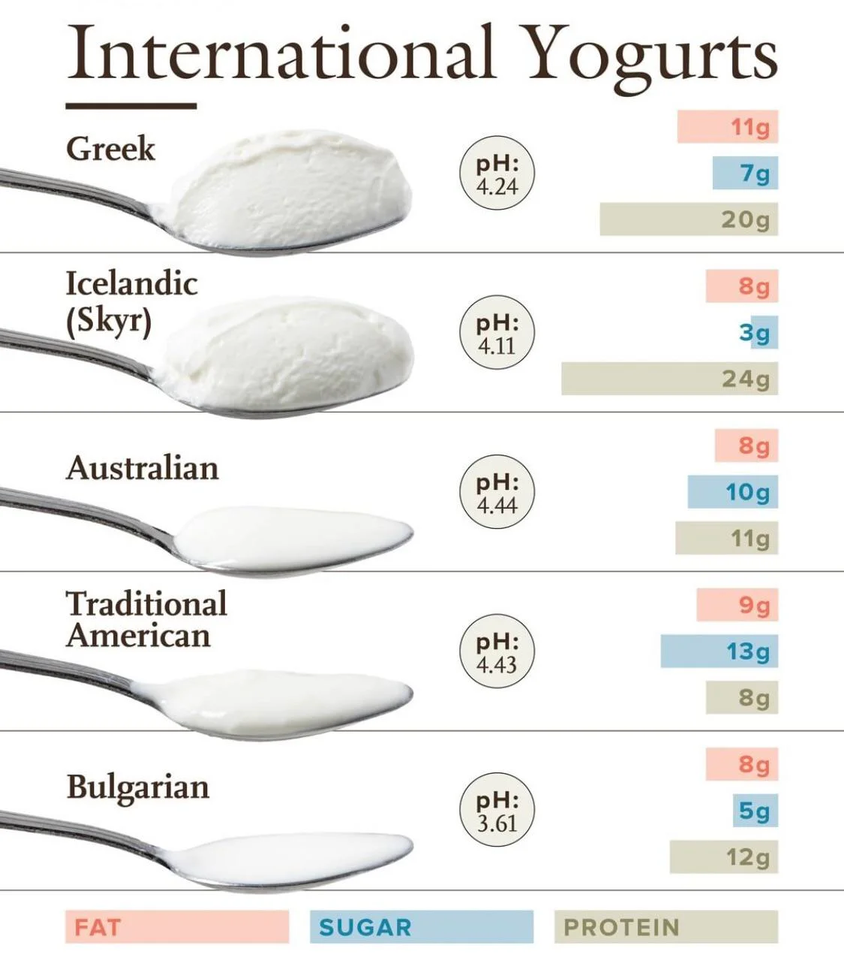
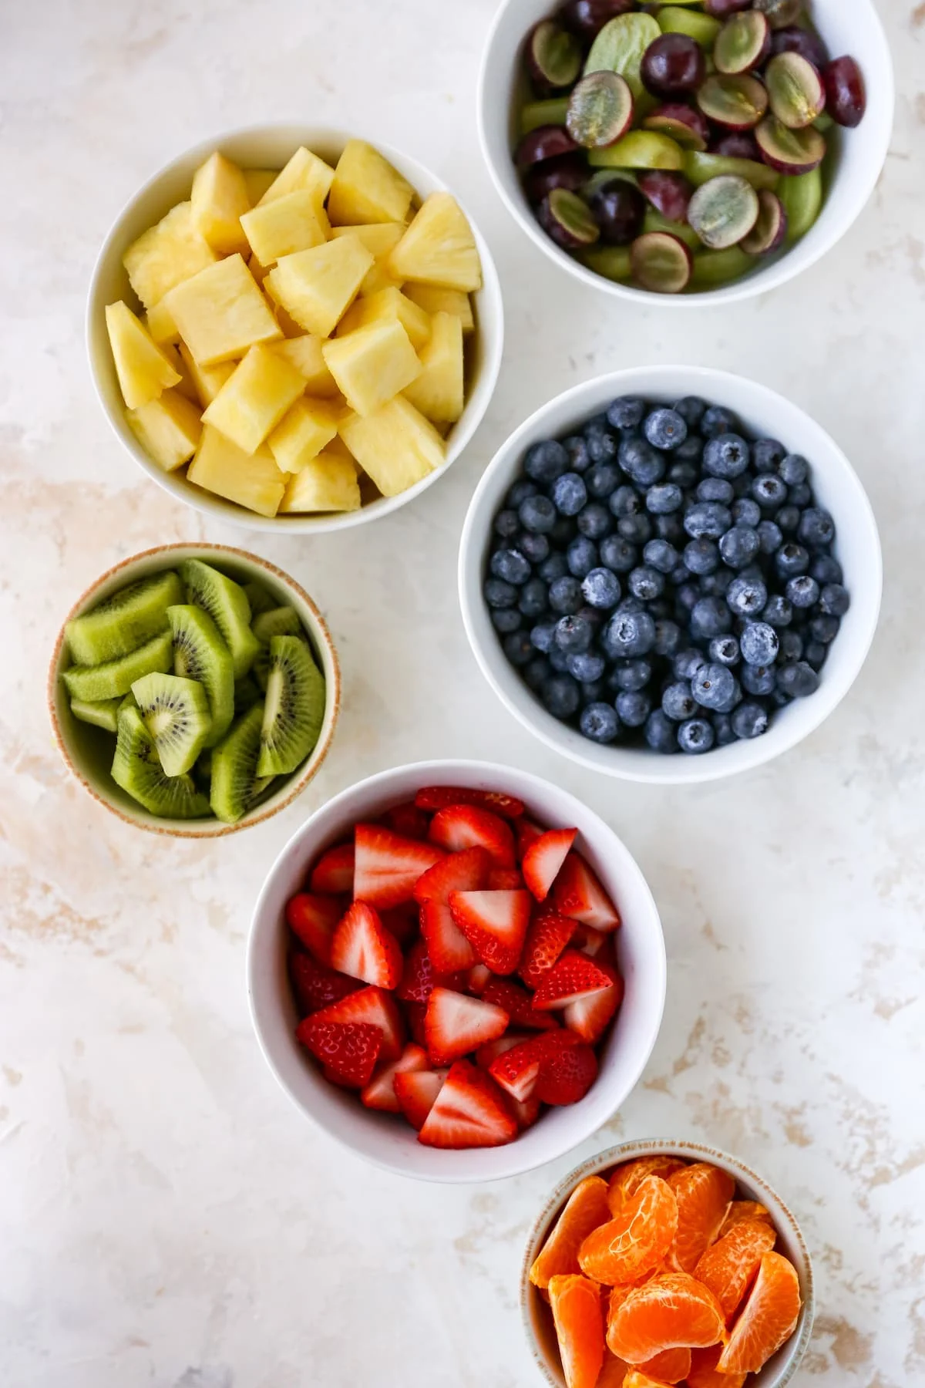

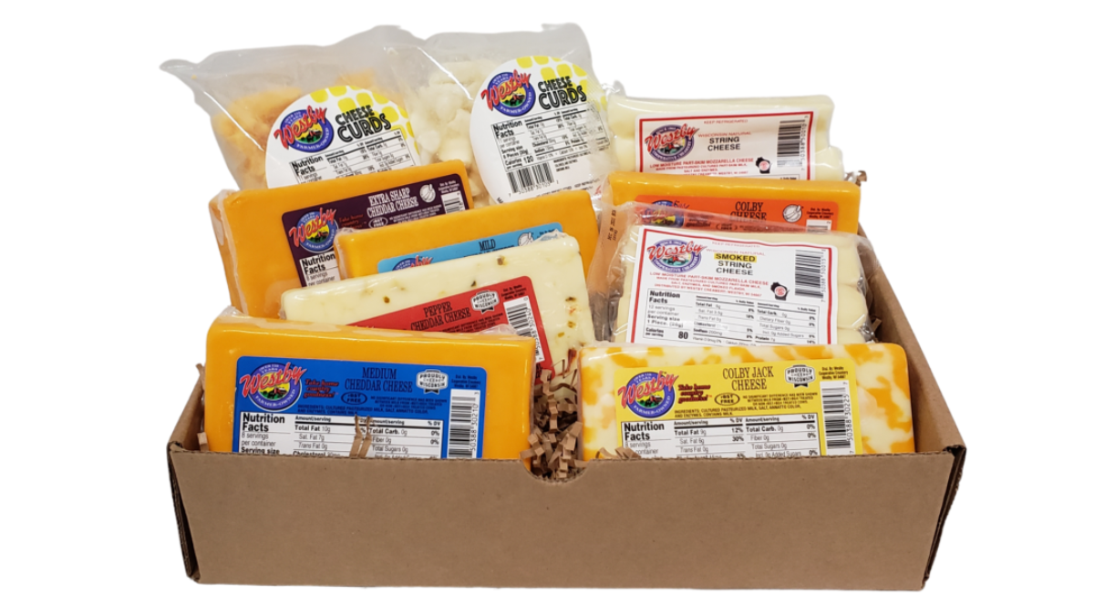
Using people as R&D specialist and Panelist
Public visit to the factory
Competitions among the participants
Preparing kits of different flavors and spices for each production line
Making their own flavors
Realizing the difference between the current product and the best product in the market
Creativity is founded on diversity & difference

Slide 6
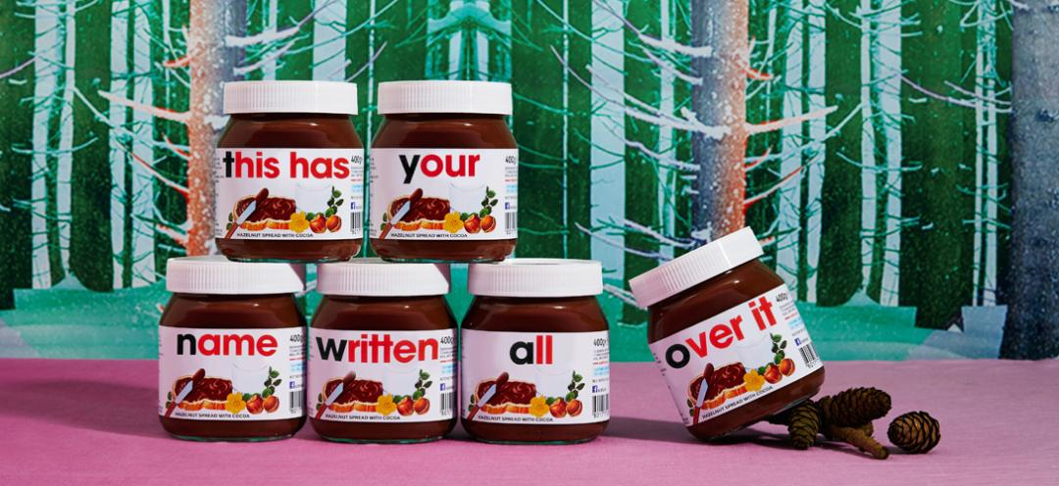
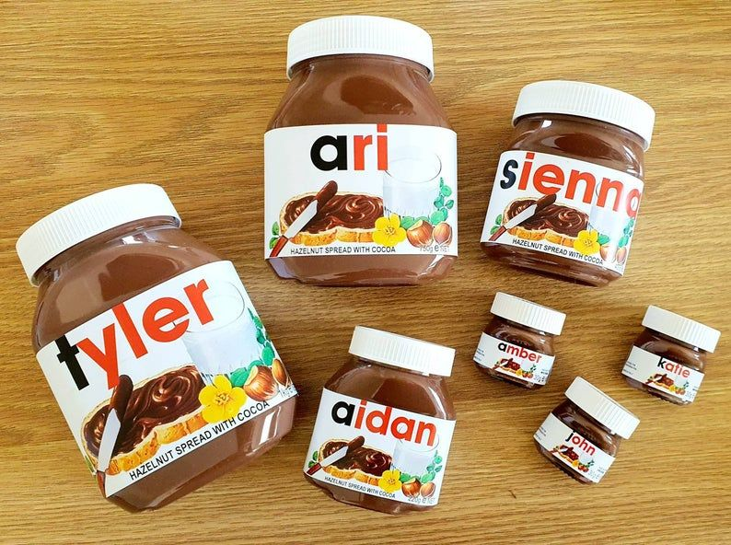
Using people as designers
Writing consumers name or comments

Slide 7
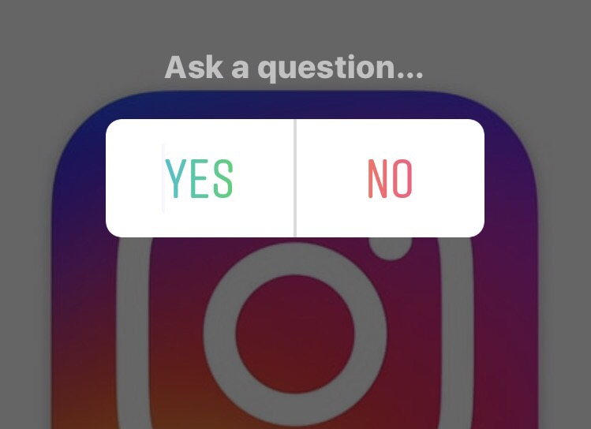
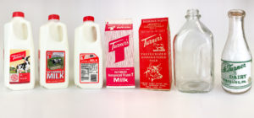

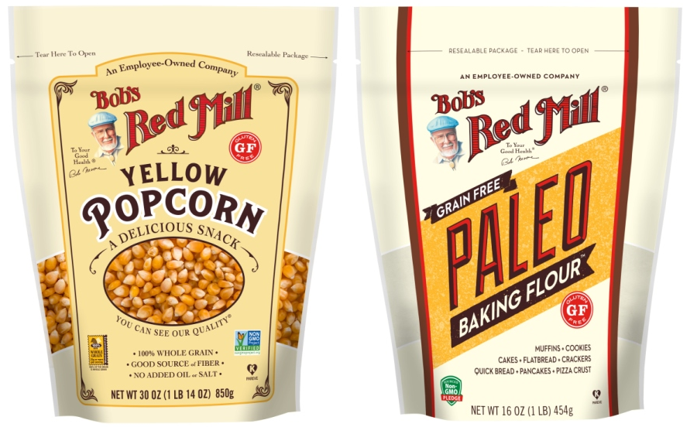
Using people as Marketing Specialist
Survey about packaging or taste of new products on social media

Slide 8
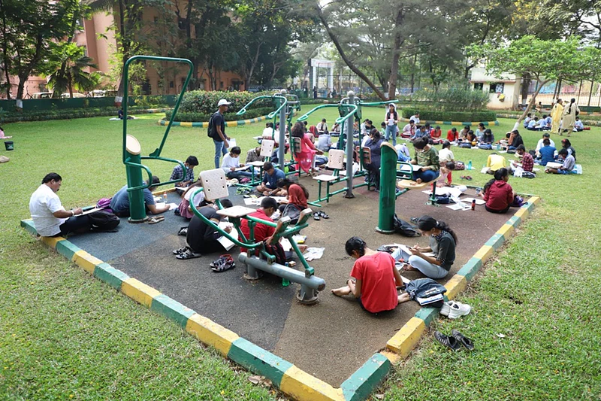
Using people of as Marketing Specialist
Holding contests for designing advertising billboards in the park
Holding advertising slogan design competitions in the park
Giving prizes to the winners chosen by the people

Slide 9
User Centered Innovation | UCI | ETM 556/656
Design a Management Process in a Dairy Company
Make a New Product Idea
Tools and Facilities
Grow the Company
Increase Revenue & Loyal Customers
Interview
&
Personal Experience
Stakeholders
End Consumer
Dep. Control Project Group
Dep. Engineering
Dep. R&D
Dep. Product
Dep.
Marketing
Dep. Procurement
Dep. HR
Make
Professor: William Dresselhaus
Presented By: Farzaneh Noroozi
Do
Say

Slide 10
اضافه کردن عکس صفحه ثبت اختراعات رامک
Innovation Department
define a new Dep. called the innovation Dep. in the system, whose task is to collect all creative ideas
define the website as the input of innovation
new product
collect all creative ideas
organization processes
all the activities that are done in the organization
Weekly collecting data
Giving Ideas to the relevant department
new business
Project Management Group (PMG)
Marketing
Engineering
Procurement
Human resource
Production
R&D
Project Management Group (PMG)

Slide 14


